Slide 1
Human-level Control through Deep Reinforcement Learning
Mnih et al, 2015

Slide 2
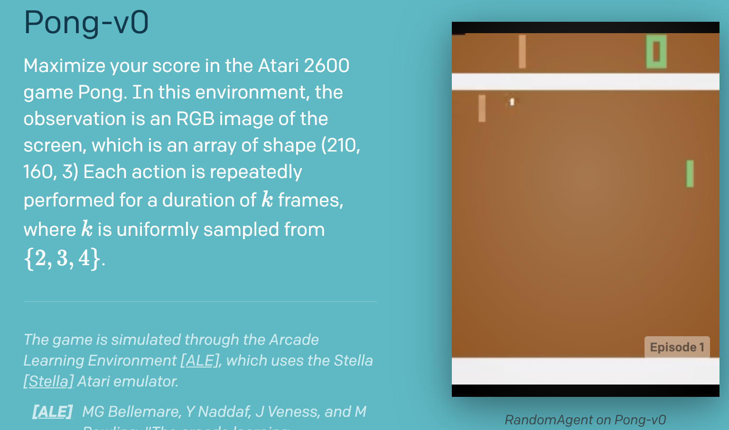
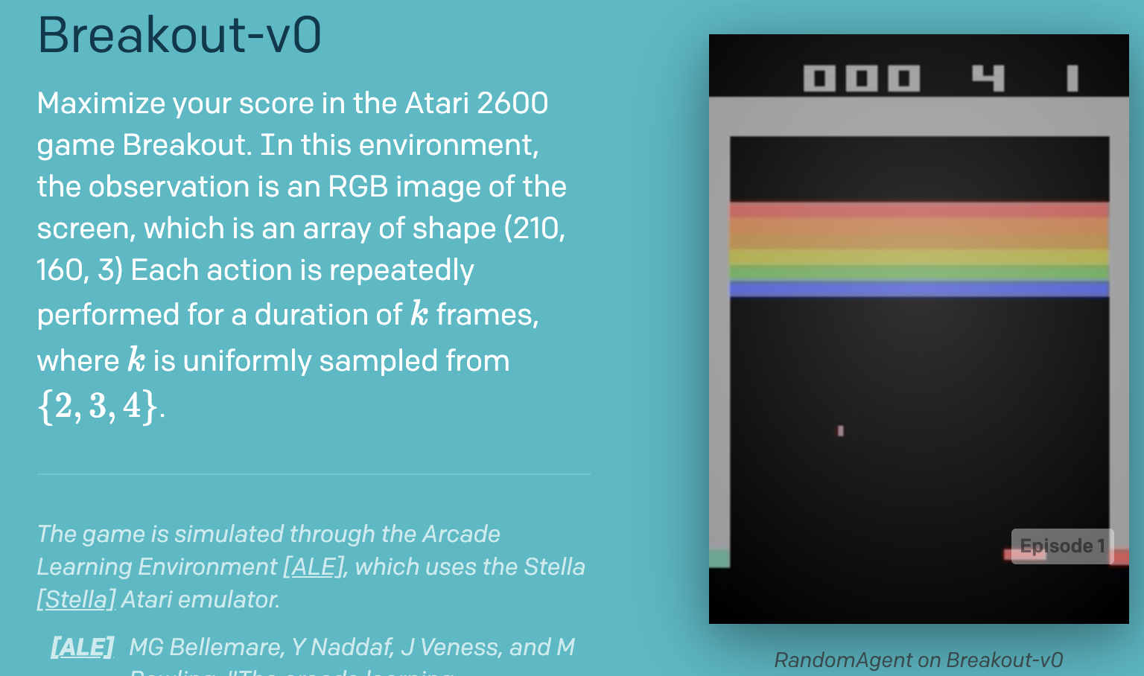
The Aim
To create an agent that would perform well in different, challenging tasks
The task for the paper is a set of 49 games from the Atari 2600 series.
The games to be used are provided as an emulator by OpenAI gym.
The agent is to be trained using Deep Q-Learning (more on this later)

Slide 3
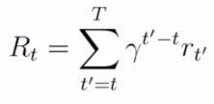
Agent and Emulator
Agent: The agent selects an action from the list of possible actions (A1, ...Ak). This it does by using a policy.
The policy improves by training, which involves playing the game a large number of times. This is done using the emulator, whose task is:
Give the image of the screen during gameplay (this will help us train the policy approximated as a CNN)
Give the game score. This will be used in the reward function for performing SGD.
The agent’s goal is to maximize future rewards. The future rewards are discounted by a factor of 0.99 in the paper, and the expression is:

Slide 4
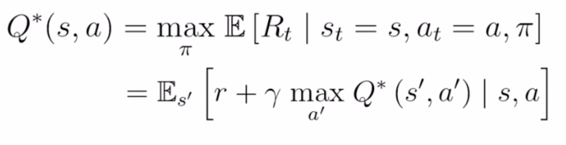
Action-value function Q
An optimal action-value function (returning the maximum possible future reward after taking an action ‘a’ from a state ‘s’ must follow the Bellman Equation (here, Q* denotes the optimal value function, and π denotes the policy (a mapping of states to actions)).

Slide 5
The Reinforcement Learning Problem
01
While it is theoretically possible to use the Bellman Equation to develop an optimal policy by working bottom’s up, it is completely infeasible.
02
The Universal Function Theorem says that neural nets can effectively approximate any mathematical function, and Deep RL uses a NN to emulate Q.
03
Thus, the general reinforcement learning problem includes an action policy, which we run on the environment, and iteratively improve using the rewards.

Slide 6
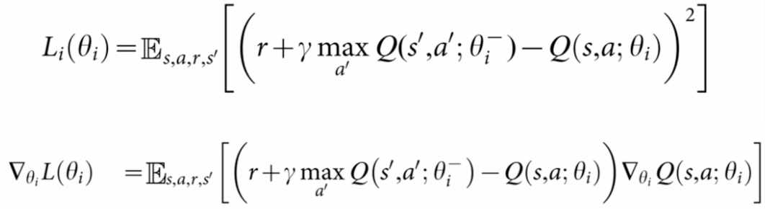
The Loss Function
The loss function is used to update the policy. Since we’re approximating the policy using a neural network, the loss function (Huber Loss is used in the paper) helps us perform SGD to change the parameters (weights of the NN in this case (actually filters in CNN)).

Slide 7
Paper’s Additions to Q Learning
Use of CNNs for Q value estimations.
Experience Replay
The Target Network

Slide 8
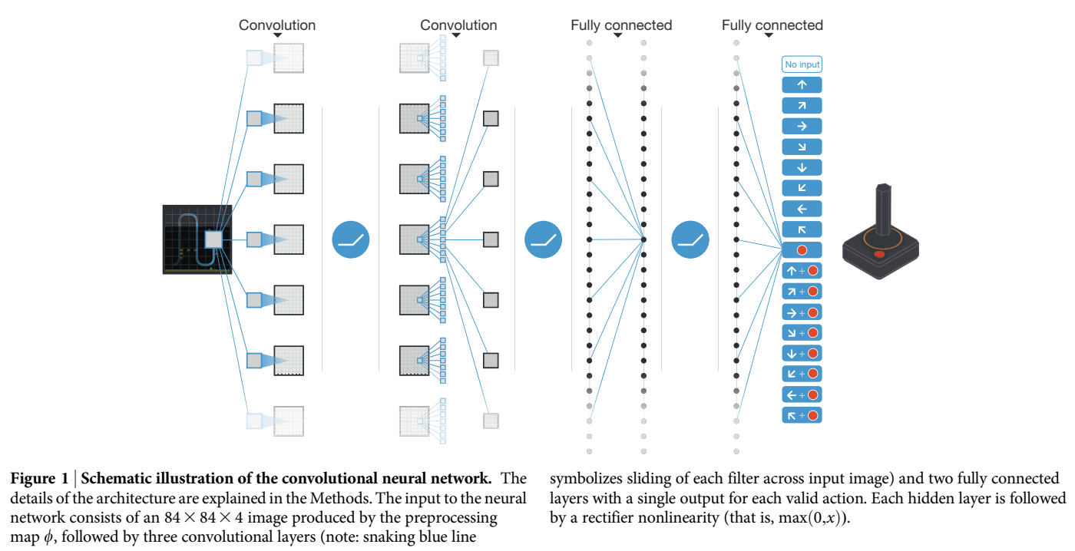

Slide 9
Experience Replay
Store a history of 100000 most recent trajectories (the states, actions, rewards and next states).
Draw random minibatch of samples from this history during training. This separates experience with learning, and thus
The purpose of experience replay is that it prevents the agent from learning from only recent experiences.
Thus, with better use of previous experience, and the independence of data, experience replay leads to better convergence.

Slide 10
Second Target Network (Q-hat)
This is a heuristic technique used by the paper to stabilize the network’s learning by decreasing the chances of divergence.
Instead of the main network Q (which we’re improving), we use a separate network Q-hat to generate the targets on each update.
Periodically, set Q-hat to be the updated main Q, thus incorporating learning into generation too.
The reason why it makes sense to do this is that it solves the “Dog chasing it’s own tail” problem

Slide 11
Training Details
RMSProp Optimizer is used in the paper. We did some study on this and found that while Adam works better, it was not invented during that time.
Annealing (like SA from AI) is done on the epsilon value from 1 to 0.1 in the first 100000 frames, after which epsilon is set to 0.1.
The network is trained for about 50 mn frames till reward saturates (we were not able to do that much with our resources, hence we only went till 1.5 mn frames, and observed the increasing rewards.
Atari images from gym are 210x160x3, which has a lot of superfluous data, hence the paper rescales them to 84x84 and grayscales.
Stack the 4 most recent frames to give velocity information.

Slide 12
Training Details (continued)
Both rewards and gradients were clipped at [-1, 1]. We experimented with and without these constraints. Clipping of gradients was done by using a “Huber Loss” for calculating loss values
Instead of every frame, the paper selects an action on every 4th frame, thus this makes it less expensive to run the emulator for one step than to have the agent select an action.
Hyperparameter search was done using “informal search” and not any formal grid search algorithm due to the curse of dimensionality.

Slide 13
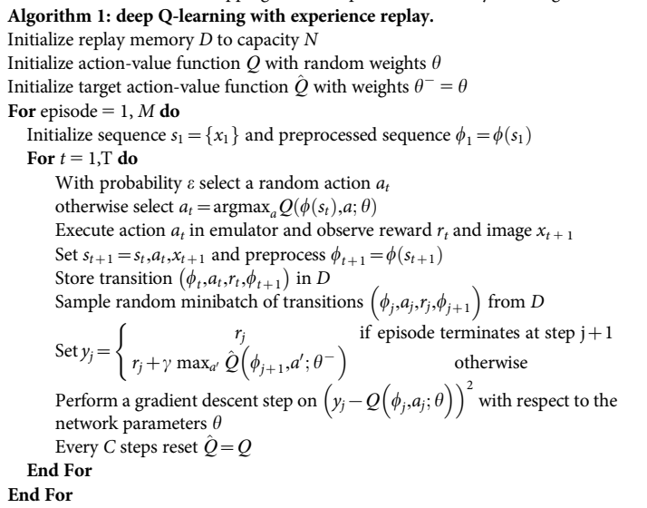
T
H
E
A
L
G
O

Slide 14
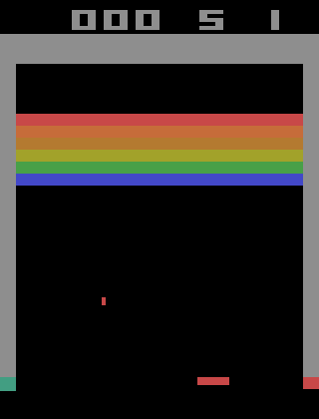
Our Results (mid training GIFs)

Slide 15
The Paper’s Results (Fully Trained GIFs)

Slide 16
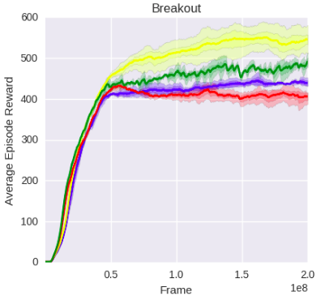
Understanding the Difference

Slide 17
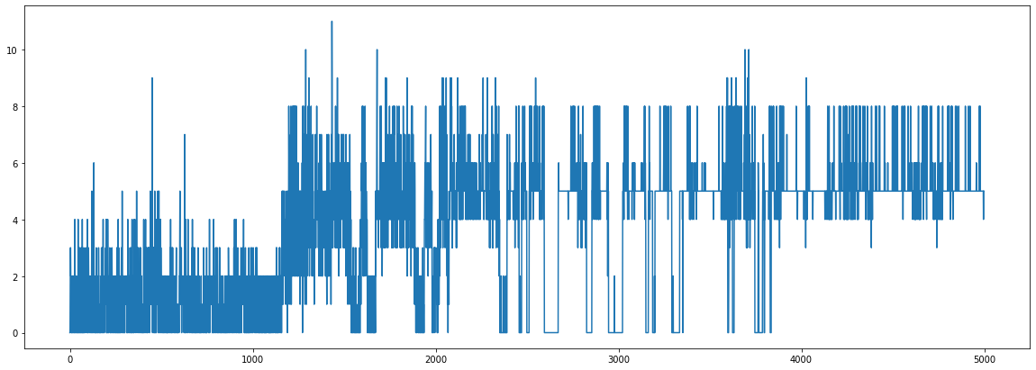
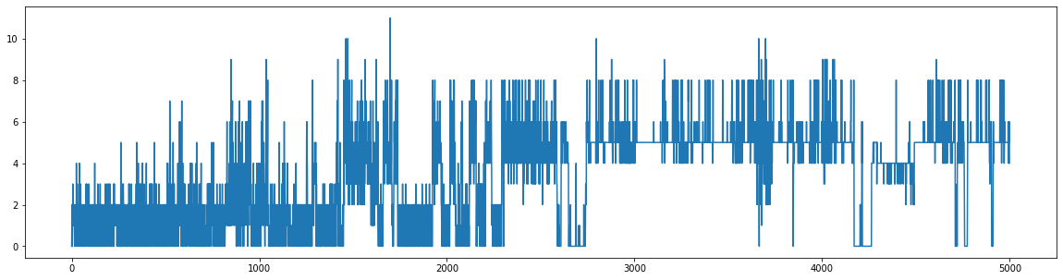
Our Results (rewards over time)
Double DQN
DQN

Slide 18
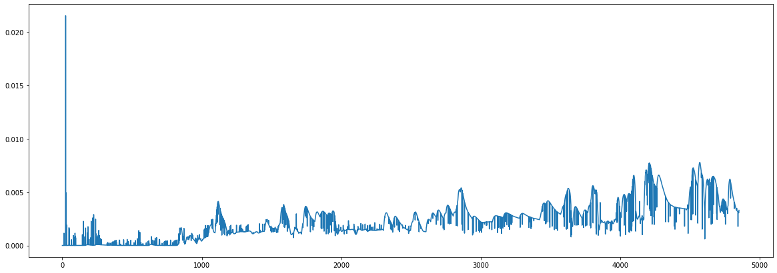
Our Results (losses over frames)

Slide 19
Further Improvements
04
Prioritised Experience Replay
Multi-step Returns
01
03
Noisy Networks
Dueling Networks Architecture
02

Slide 20
